Slide 2
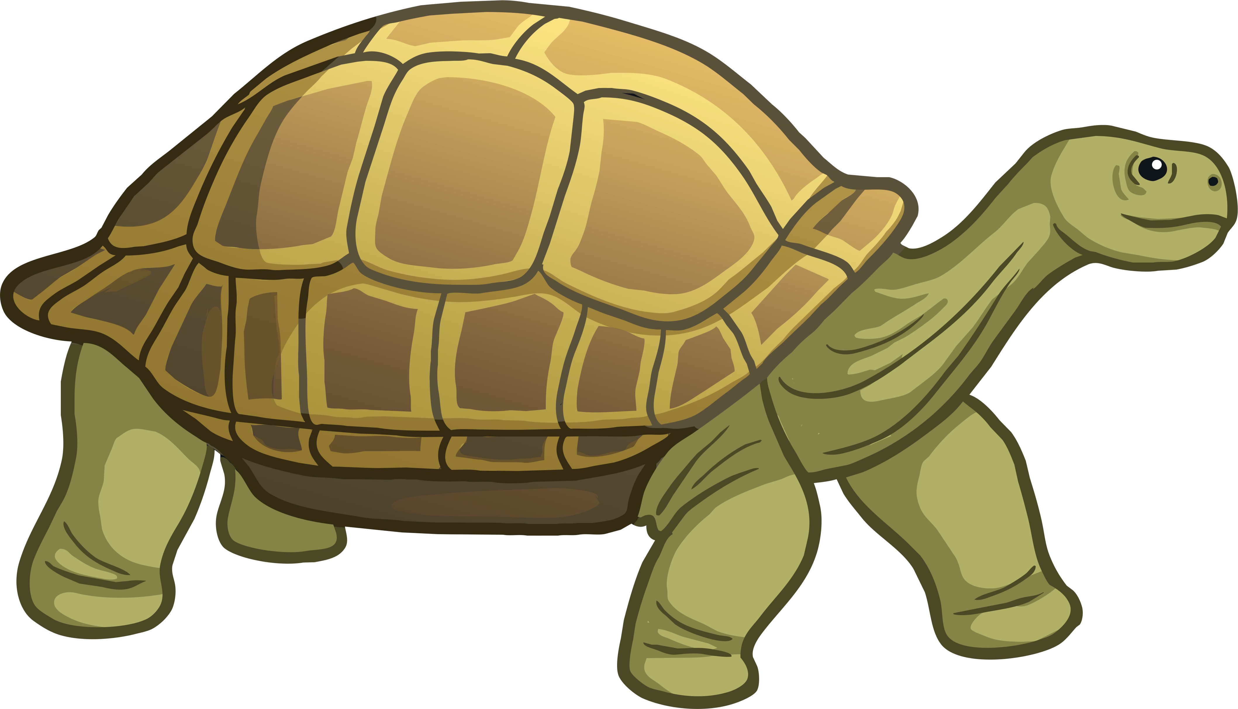
Daily News
Animals x World News
4th February 2019
‘Extinct’ Giant Tortoise Found after 100 Years
Scientists have found a species of giant tortoise no one had seen for over 100 years!
Fernandina giant tortoises live on the small island of Fernandina. It’s part of the Galapagos archipelago. These are 19 islands in the Pacific Ocean which are famous for being the place where Charles Darwin developed his theory of evolution.
Most scientists had thought that the species was probably extinct. Many were killed for food and their oil in the last 200 years.
However, scientists have found a 100-year-old adult female Fernandina giant tortoise on the island! They’ve also found footprints and giant tortoise poo so they think there might be more living on the island.
The tortoise has been taken to a nearby island for health and genetics checks.
Read the full article online here.
Where are the Galapagos islands?
What is evolution?
Why are the giant tortoises endangered?
Photo: Giant tortoises can live for over 100 years.
Notes:
Teacher Note - Please do not let the next video automatically play at the end of the clip. Please check the content in this link, including any comments, is suitable for your educational environment before showing. Twinkl accepts no responsibility for the content of third party websites.

Slide 4
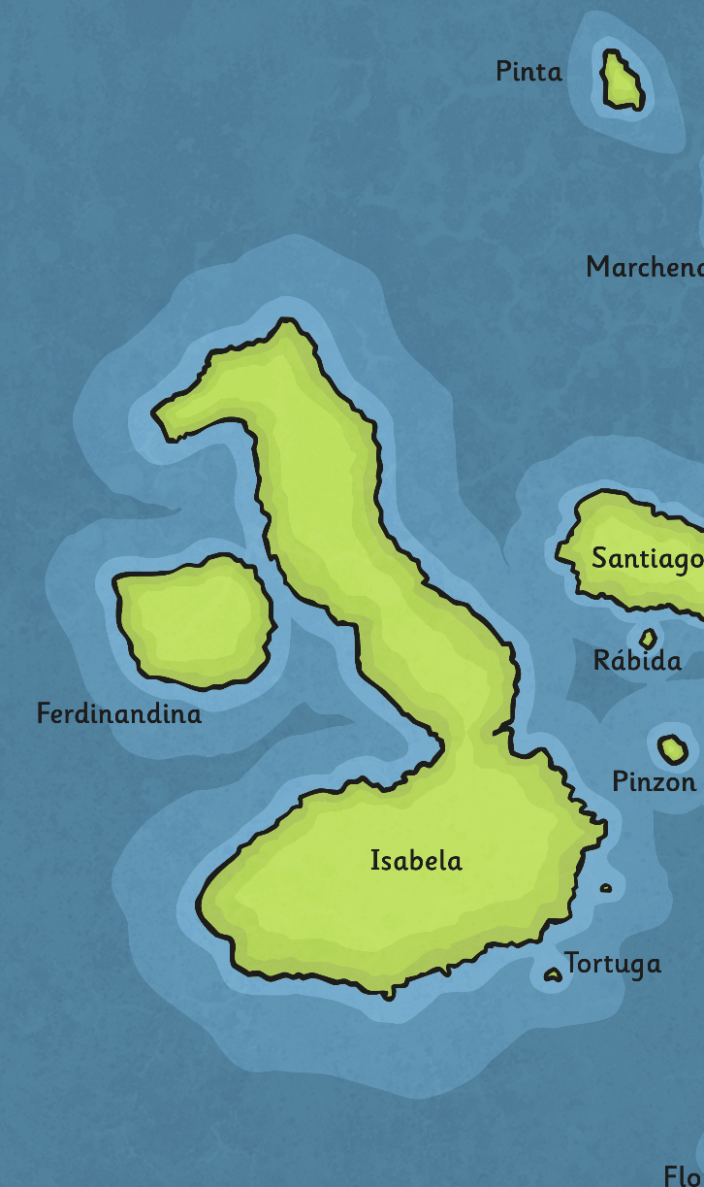
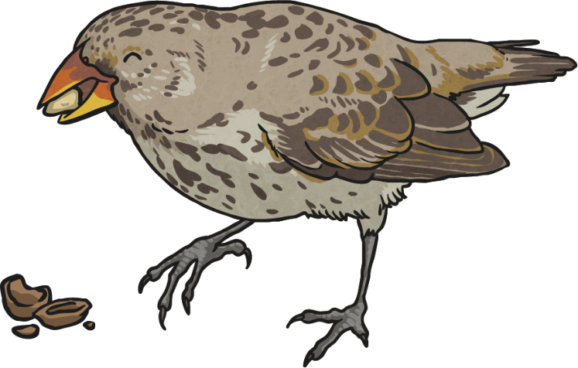
Where Are the Galapagos Islands?
especially
environment
developed
The Galapagos islands are in the Pacific Ocean, about 620 miles from the coast of Ecuador, in South America.
The islands are very remote.
While many of the animals on the island are similar to each other, they have developed in different ways.
The archipelago is made up of 19 islands. The largest is Isabela and is around 82 miles long.
In 1835, Charles Darwin spotted that the finches on the islands had very different beaks, suited to the food found on that island.
The islands are all volcanic. This means they are formed of lava piles and volcanoes.
Use an atlas to find the Galapagos islands.
The Galapagos are especially famous for their environment and wildlife.
This was an important part of his theory of evolution.
What else do you know about Charles Darwin?

Slide 5
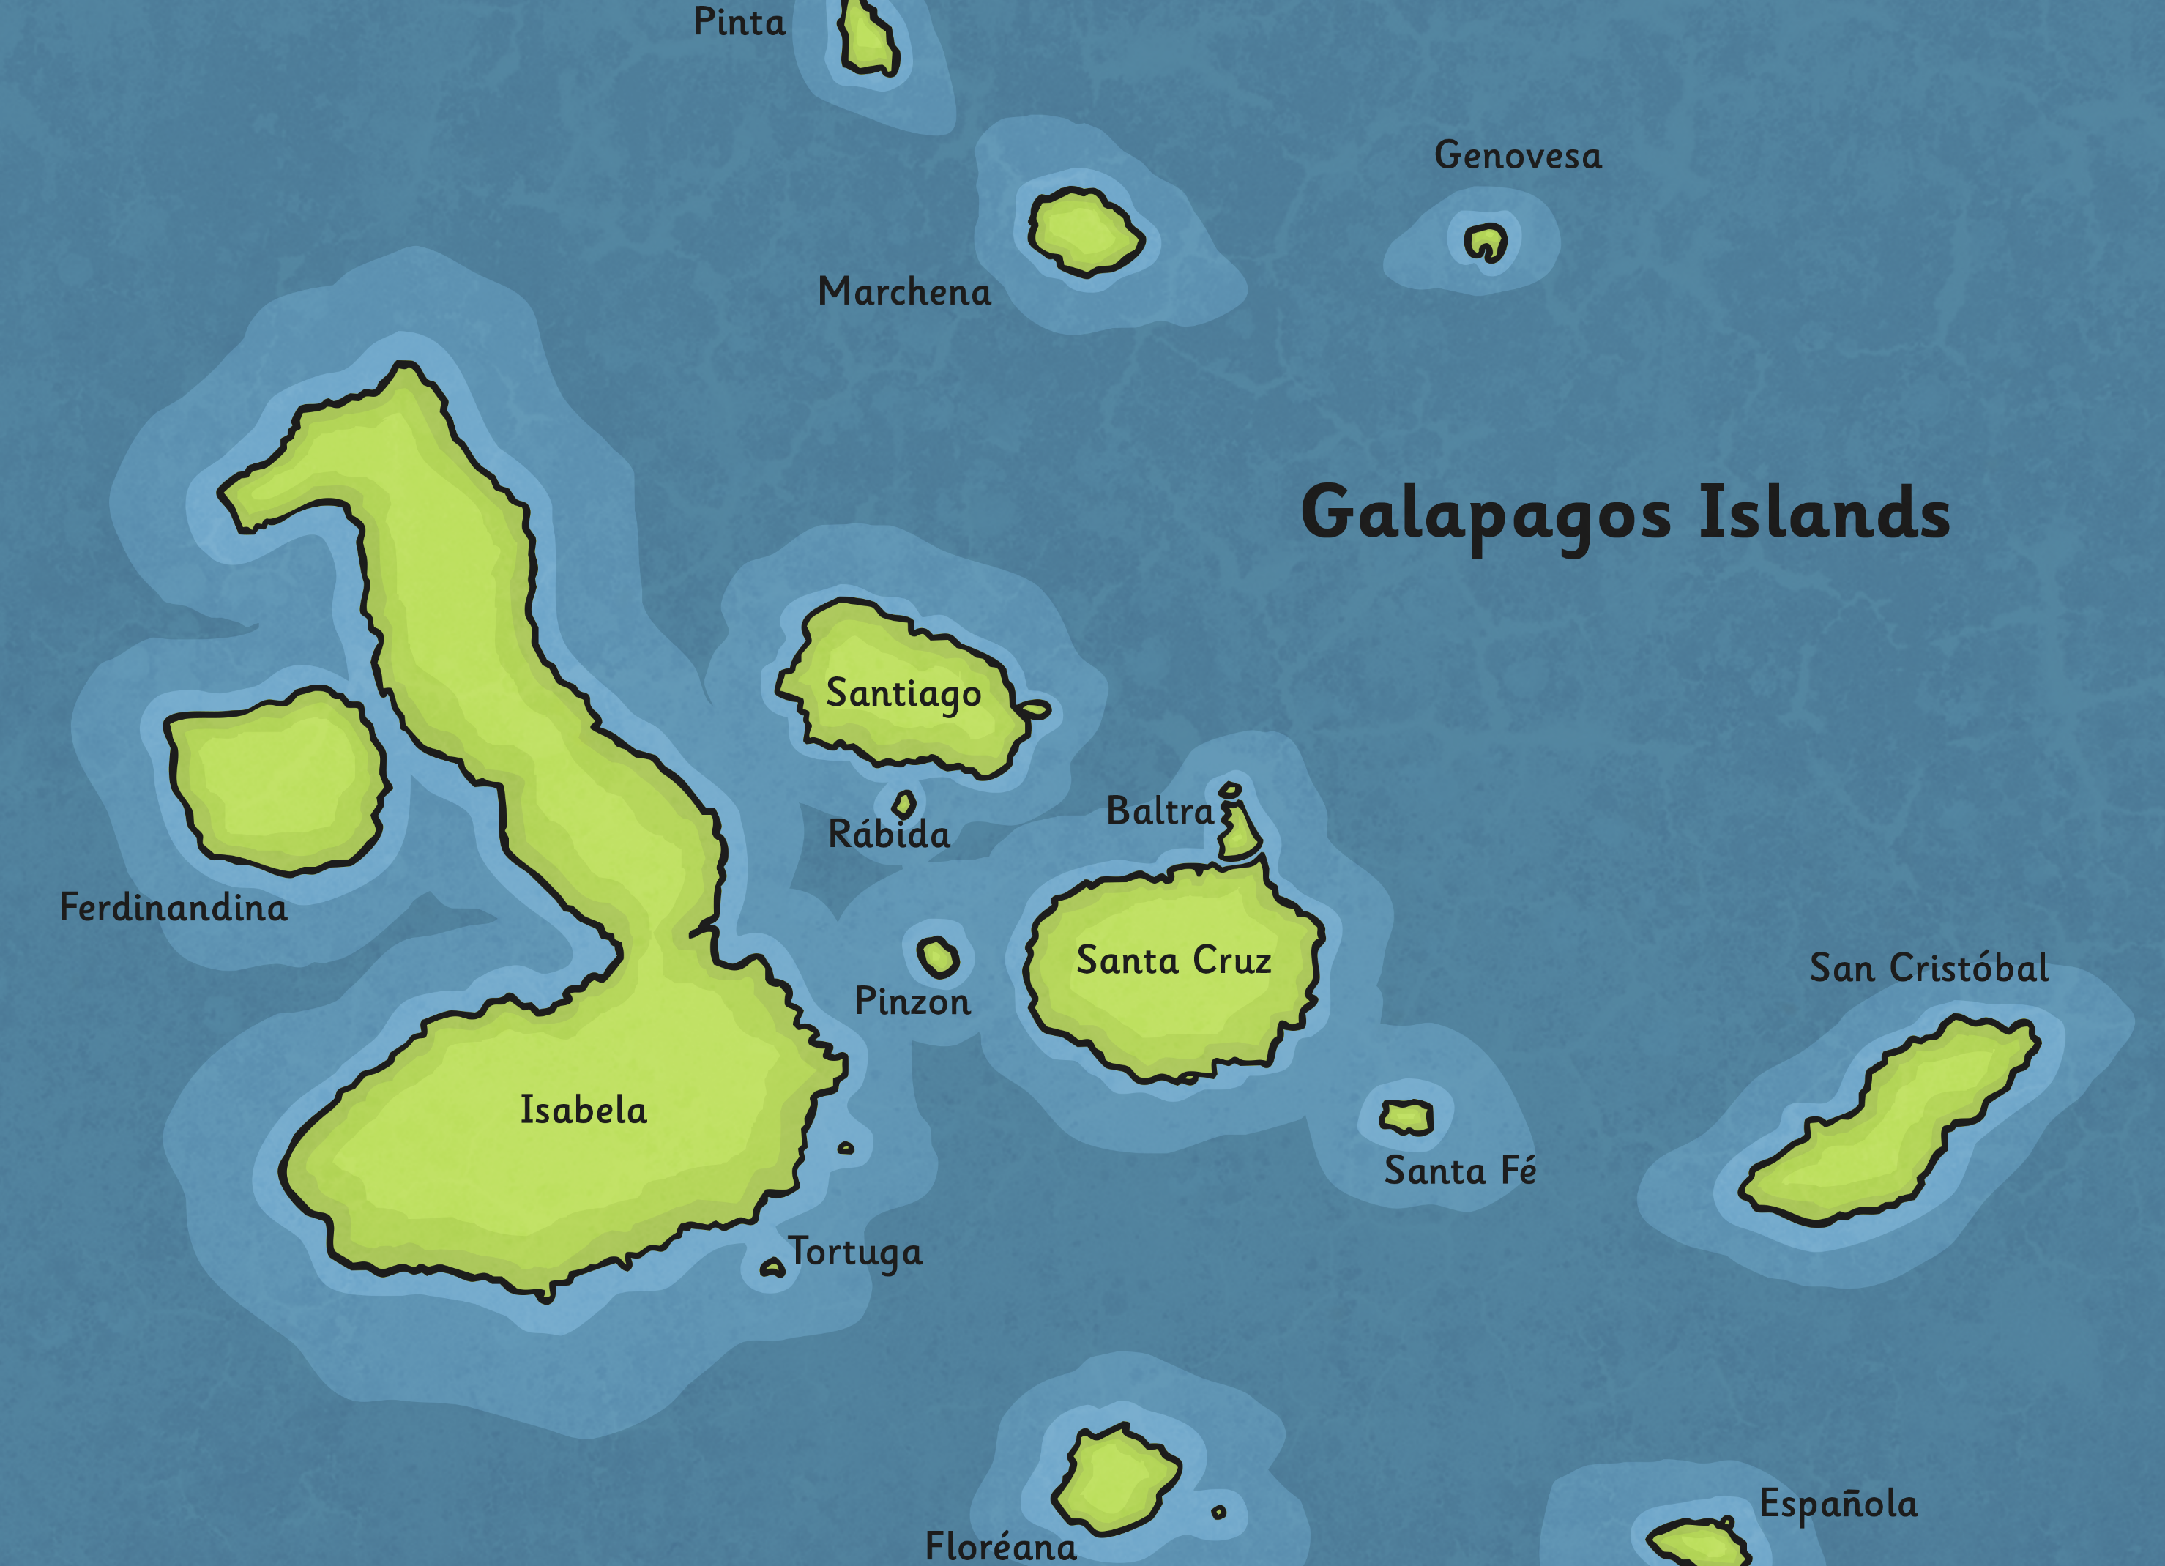

Slide 6
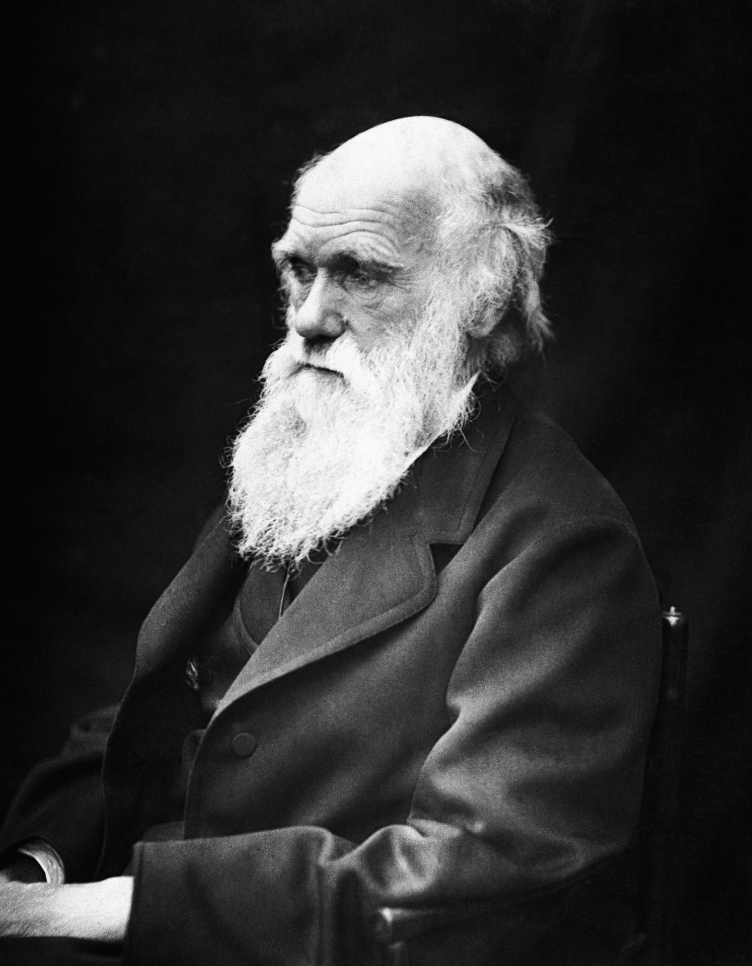
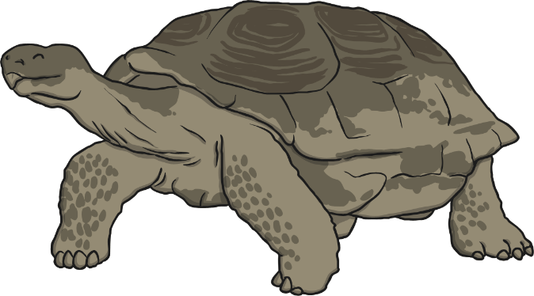
What Is Evolution?
develop
variety
environment
recognised
Over millions of years, living things change and adapt to their habitat.
Over time, the species will have adapted to suit its environment.
Animals develop differently and get a variety of small differences.
Each of the 15 different species of giant tortoises on the Galapagos islands has developed differently to suit the island.
Some of these are helpful to an animal’s survival, such as thick fur.
These differences are accidental but useful. Animals with these differences are more likely to survive and pass on these traits.
Find out more about evolution here.
Charles Darwin recognised this when he was on the Galapagos islands. It helped him form the theory of evolution.
What other animals have adapted to their environment?

Slide 8
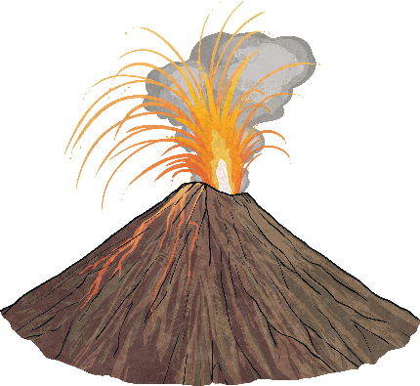
Why Are the Giant Tortoises Endangered?
frequently
existence
foreign
When Darwin arrived at the Galapagos islands in 1835, there were 15 types of giant tortoises in existence.
Their habitat has also been threatened to make space for grazing cattle.
Living on a volcanic island doesn’t help. Scientists believe that lava from volcanos also threaten the species.
Scientists believe four of these are probably now extinct and most of the others are endangered.
Over the last 200 years they have been frequently hunted for food.
However, the recent discovery has given scientists hope.
Write a plan to protect the giant tortoises
Some foreign species introduced to the islands, such as dogs and cats, also hunt young tortoises.
With new conservation work, the number of giant tortoises might increase.
What could be done to protect the giant tortoises?

Slide 10
Glossary
Word | Definition
species | A group of living things which are similar and can have young.
archipelago | A group or chain of islands.
evolution | The process of living things adapting and developing from their earlier forms.
genetic | Related to the study of genes, DNA and identifying species.

