Slide 2
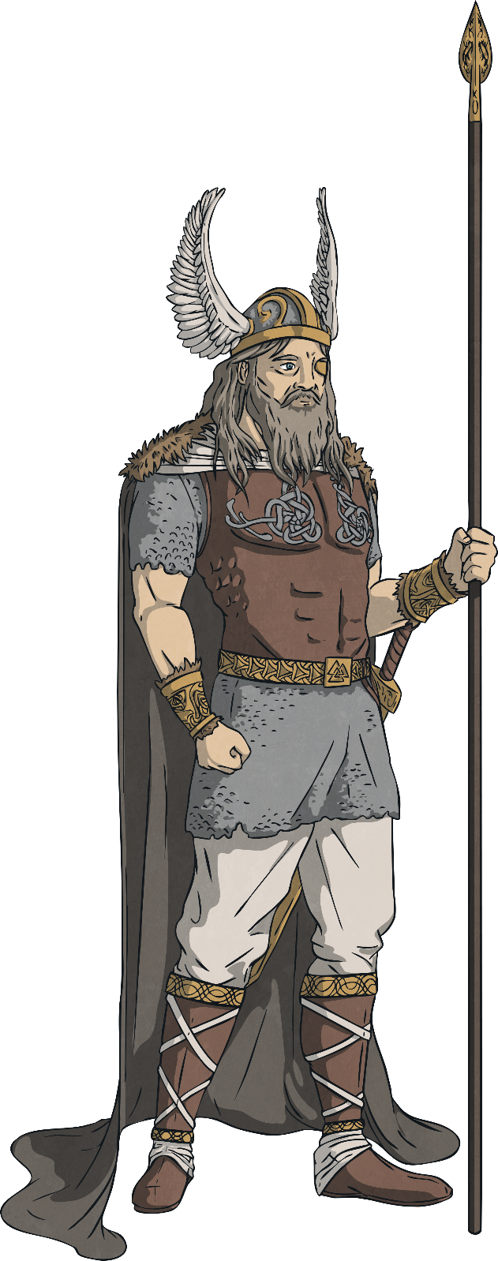
Odin
God of: Odin was the chief and most important god of them all.
He ruled in Asgard and is the father of Thor. He rode an eight-legged horse.
He liked to roam the Earth in disguise in order to be with women he fell in love with.

Slide 3
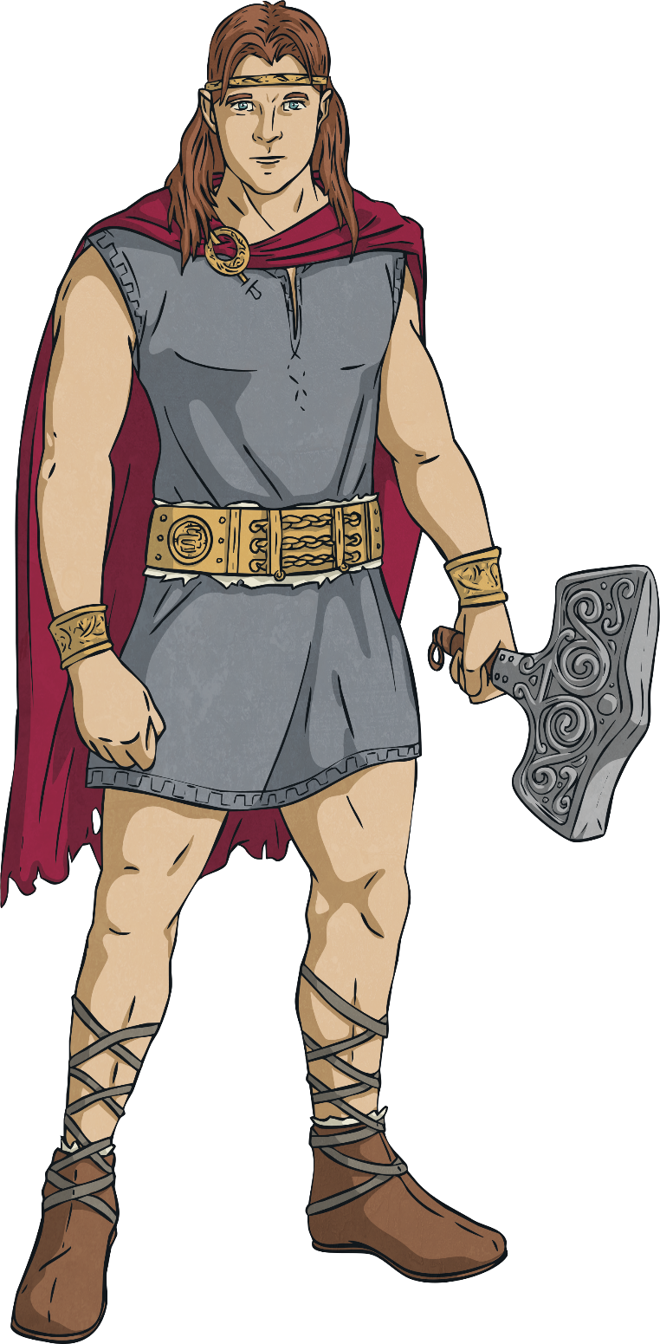
Thor
God of: thunder, fertility, the sky and law
Son of Odin and Fjorgyn, he had super strength and an enchanted hammer that could destroy most things. He was the most popular god as he has a good heart.
He is a relative of Loki.

Slide 4
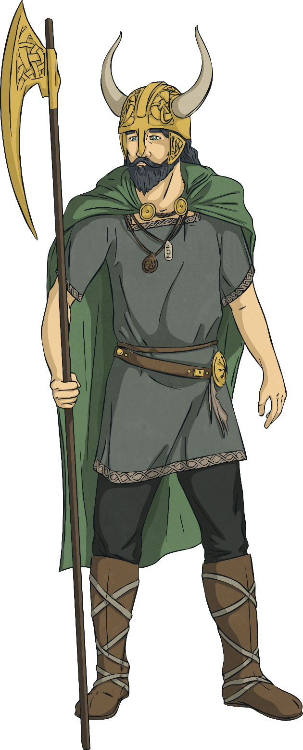
Loki
God of: mischief and chaos
Loki is known as a naughty god, who lied and betrayed the other Gods.
It was said that his relationship with Thor was a rather strange one.

Slide 5
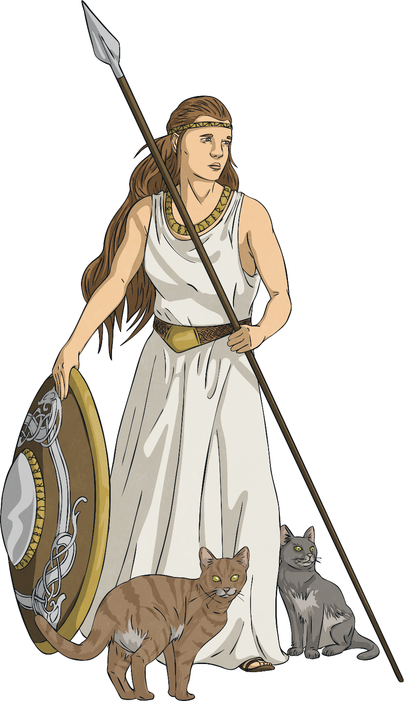
Freya
God of: love, beauty, fertility and war
She was married to the God Od, who abandoned her.
She has been known to appear as a bird to people and made sure the sun shone, rain fell and crops grew.

Slide 6
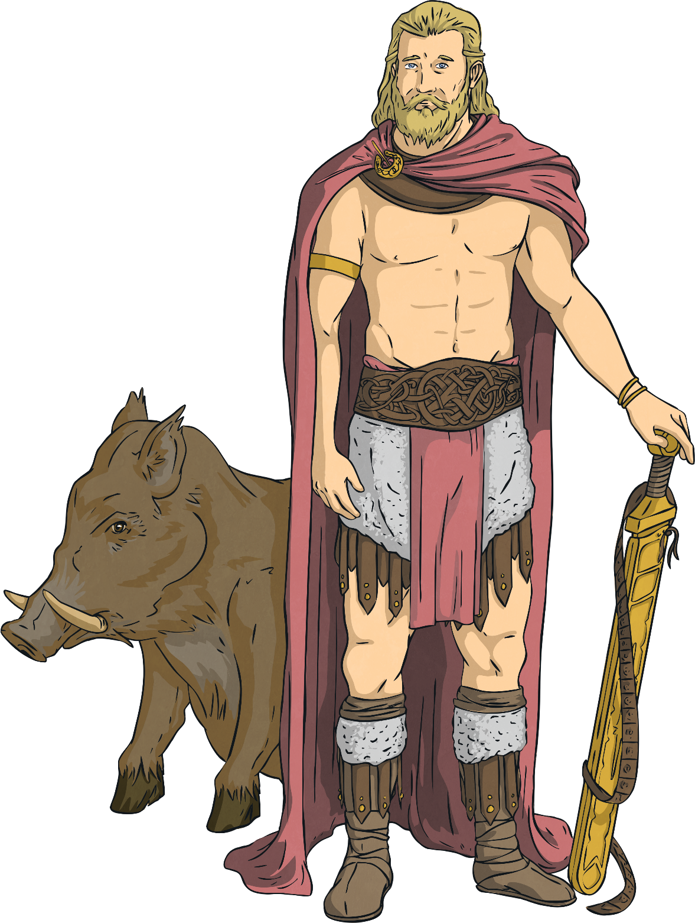
Frey
God of: fertility
He was the son of Njord. He arrived at Asgard as a hostage along with his sister Freya and his father.

Slide 7
Task
Now use your worksheets to draw your favourite God and write about them.

